Slide 1



Route Planning
With Different Search Algorithms

Slide 2
Table of contents
01
Overview
02
Approach
03
Implementation
04
Data Analysis and Conclusion

Slide 3
Problem Overview
01

Slide 4

Our program
Find the shortest route between two Vietnamese cities.
The objective: minimize the number of kms traveled between two cities.

Slide 5
Approach
02

Slide 6


Algorithms
UCS
GBFS
A*
f(n) = g(n)
g(n) is the is the path cost of moving to a node n.
f(n) = h(n)
$h_{SLD}\left(n\right)=$Estimated straight-line distance from n to the end city.
f(n) = g(n) + h(n)
$h_{SLD}\left(n\right)=$Estimated straight-line distance from n to the end city.

Slide 7
Output
Time Complexity
The Path
Space Complexity
The distance
Number of nodes expanded
Return solution if any
Number of nodes kept in memory
The cumulated number of km of the solution

Slide 8
Data Analysis
Visualization

Slide 9
Implementation
03

Slide 10

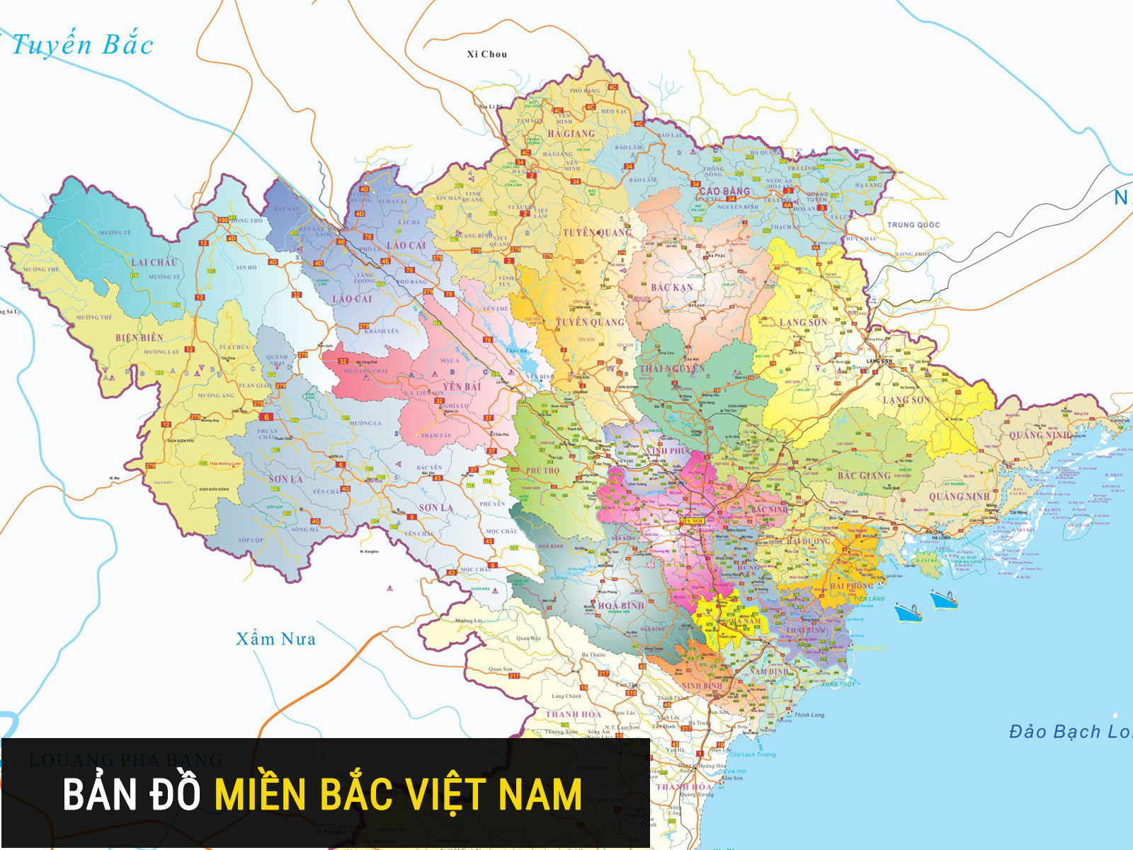
Input Data
City Map (Coordinates, Adjacency, Distances)
Heuristic Distance Between Cities

Slide 11
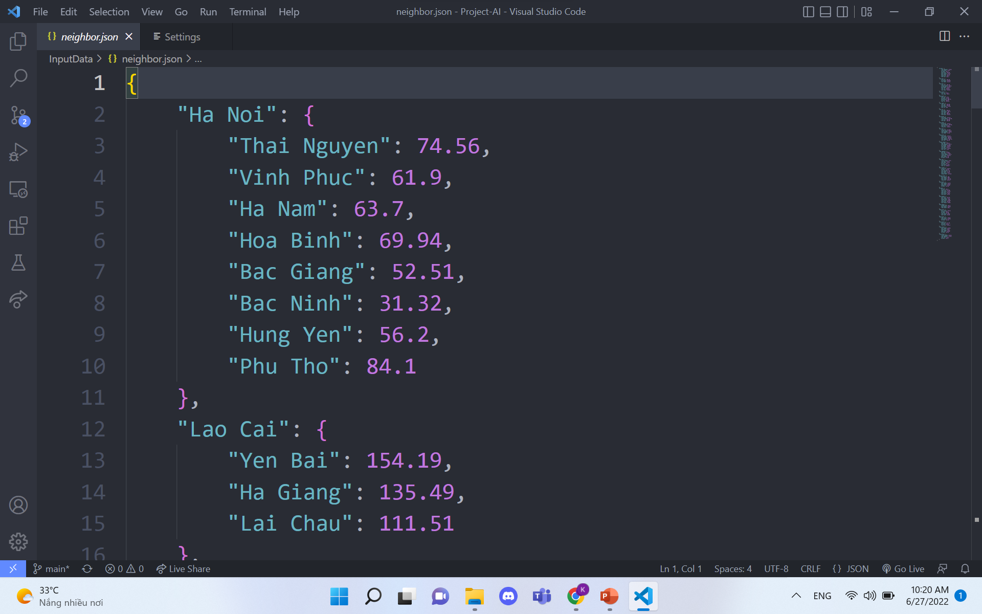
JSON Files
City Map: Neighbor.json
Heuristic Distance: Sld.json
Data Format: Nested Dictionary

Slide 12
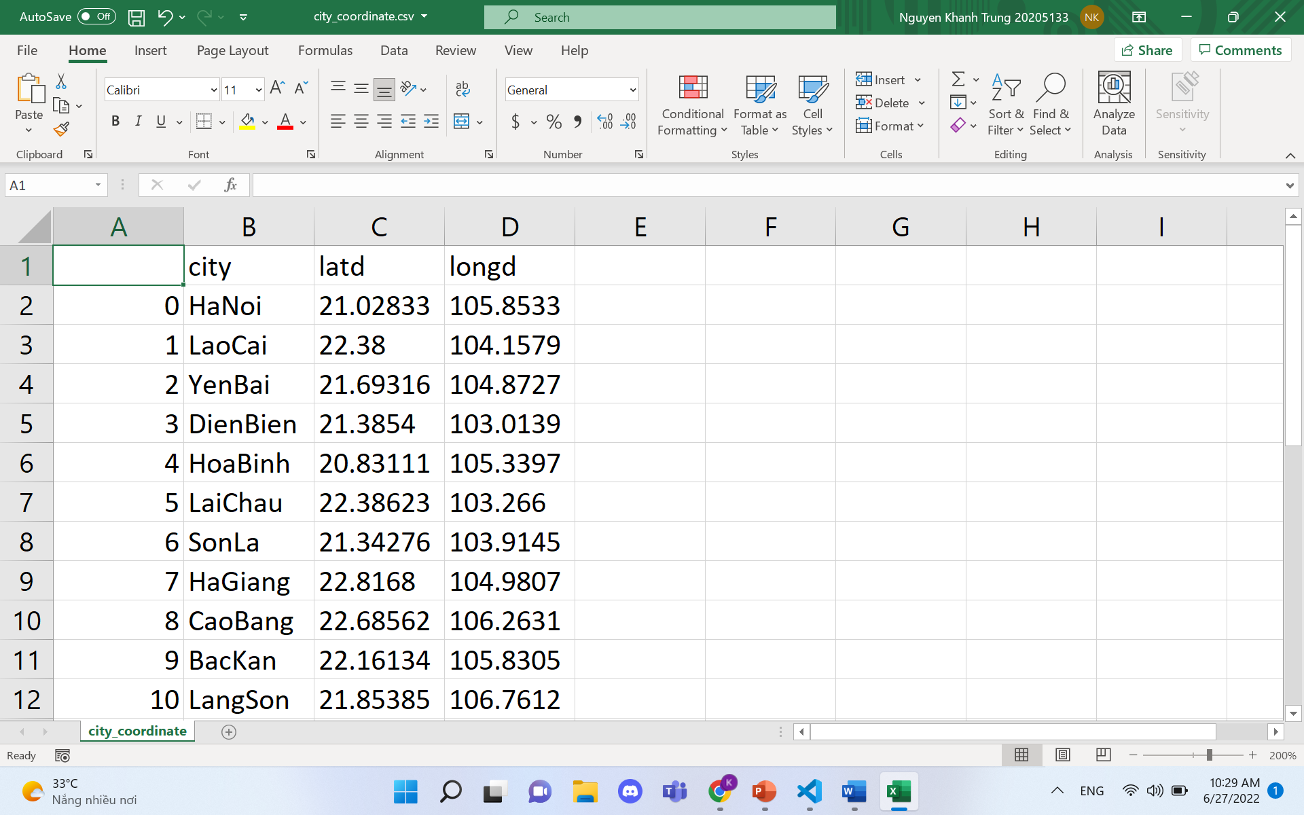
CSV Files
City Coordinate: city_coordinate.csv
Map Edges: neighbor.csv
Data Format: Data Sheet

Slide 13
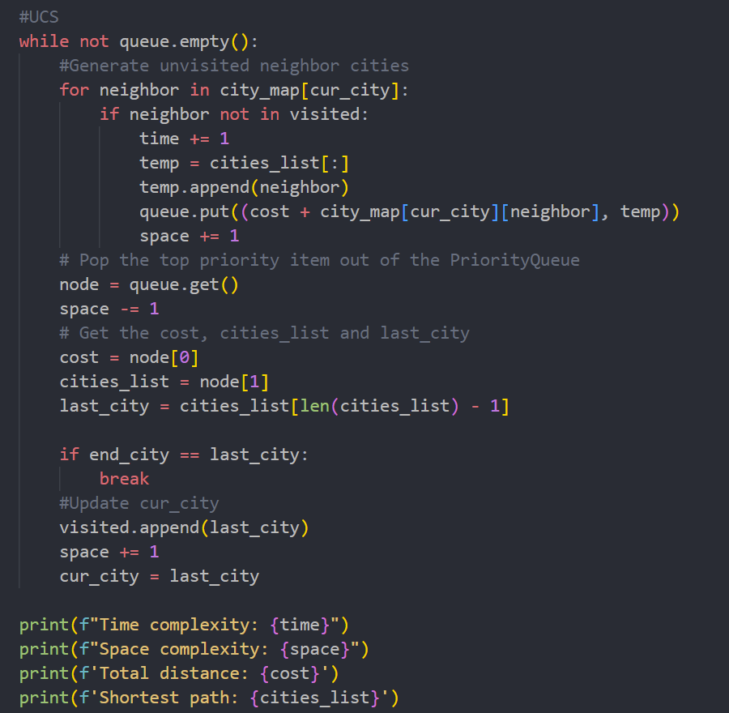
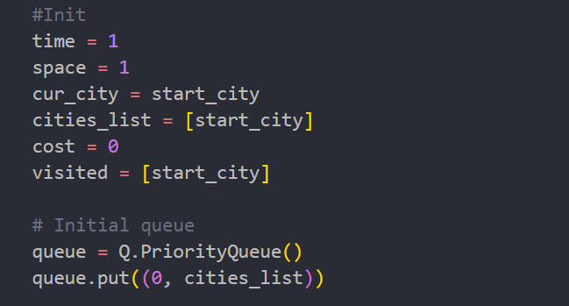
Algorithm: UCS
UCS
The fringe is implemented as a Priority Queue.
Each node generated is stored in a tuple of the form: (cost, path).

Slide 14
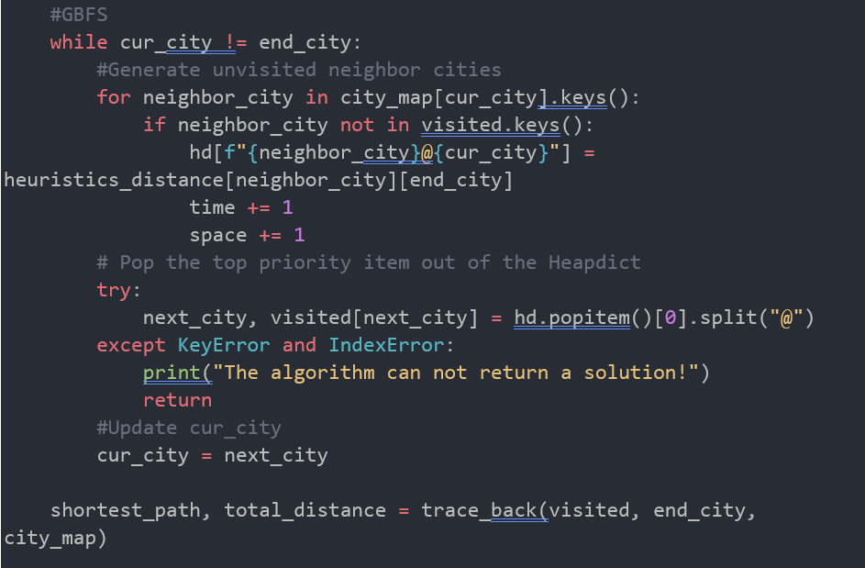
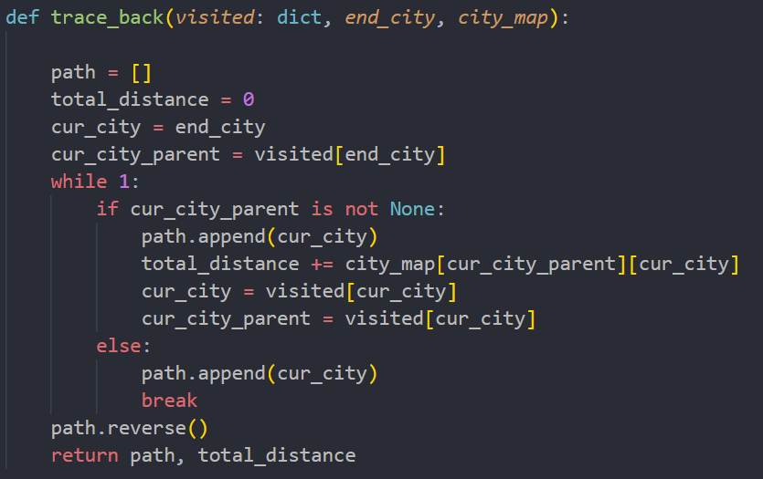
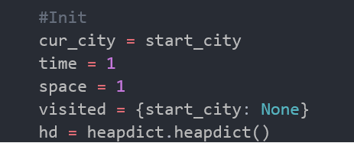
Algorithm: GBFS
GBFS
The fringe is implemented as a Heap Dictionary.
Each node generated is stored as a key-value pair of the form: {city}@{parent_city} : h(city).
→ Easy for traceback of the path later on

Slide 15
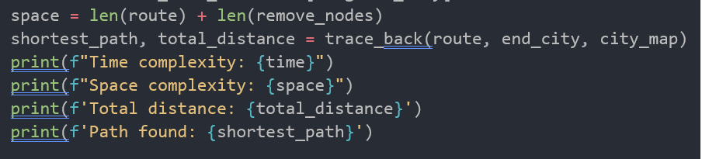
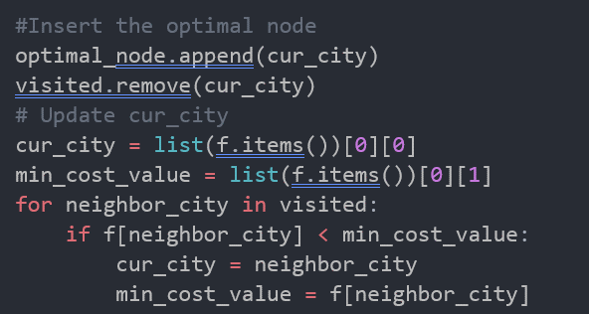
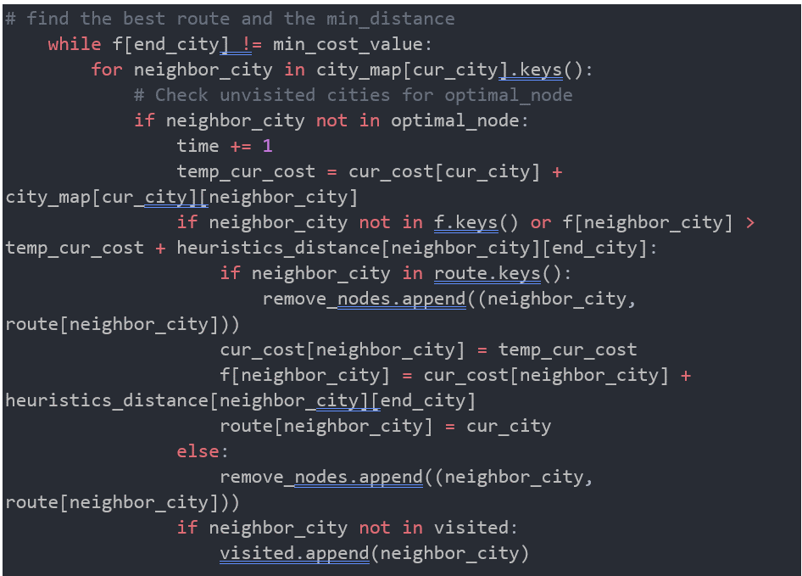
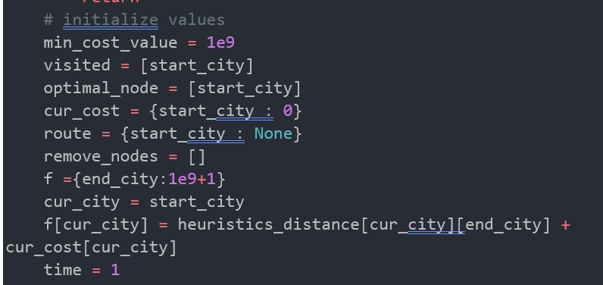
Algorithm: A*
A*
Nodes generated are divided into two parts route and remove_node.
route: a dictionary storing currently optimal cities and their respective parent cities).
remove_nodes: a list of out of date or nonoptimal nodes.

Slide 16
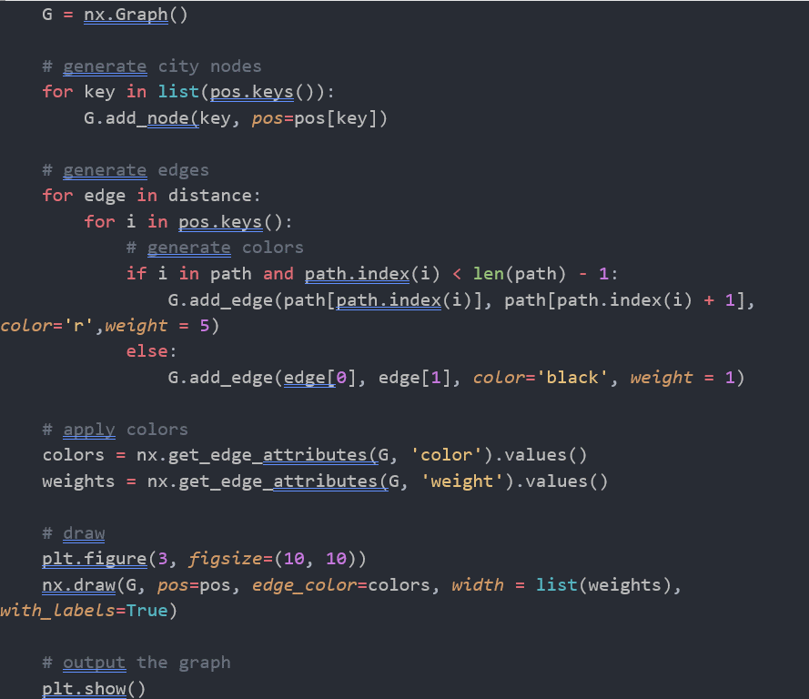
Visualization
Visualization
Read the coordinate of the cities and their respective neighbors
Generate data for city_coordinates and neighbors.
Draw nodes, edges and colors (this includes the path returned by the chosen algorithm highlighted in red).
Show the graph.

Slide 17
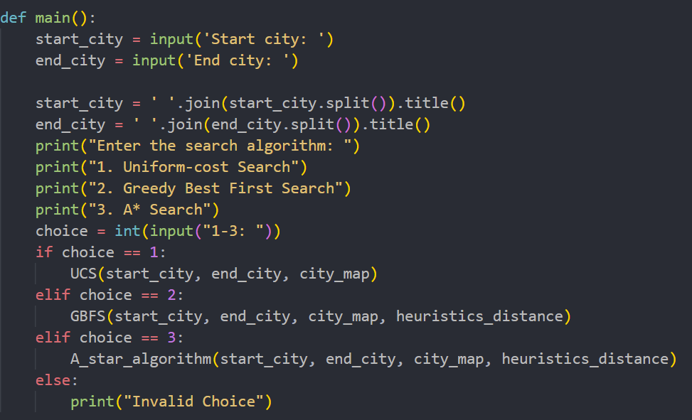
Menu
Menu
Let the user input the start city and end city.
Display the available algorithms and let the user choose one among them.
Execute the chosen algorithm and display the solution.

Slide 18
Demo

Slide 19
Data Analysis and Conclusion
04

Slide 20
Overview
UCS
GBFS
A*
f(n) = g(n)
g(n) is the is the path cost of moving to a node n.
f(n) = h(n)
$h_{SLD}\left(n\right)=$Estimated straight-line distance from n to the end city.
f(n) = g(n) + h(n)
$h_{SLD}\left(n\right)=$Estimated straight-line distance from n to the end city.

Slide 21
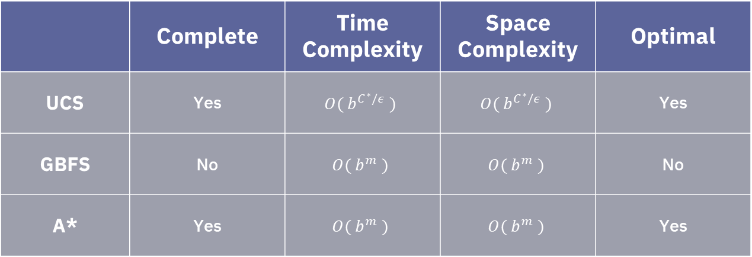
Overview
 | Complete | Time Complexity | Space Complexity | Optimal
UCS | Yes | $$O( b^{C^{∗}/ε} )$$ | $$O( b^{C^{∗}/ε} )$$ | Yes
GBFS | No | $$O( b^{m} )$$ | $$O( b^{m} )$$ | No
A* | Yes | $$O( b^{m} )$$ | $$O( b^{m} )$$ | Yes

Slide 22
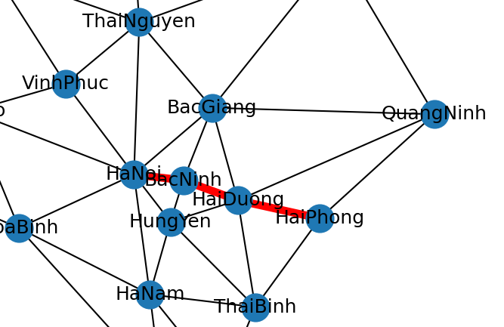
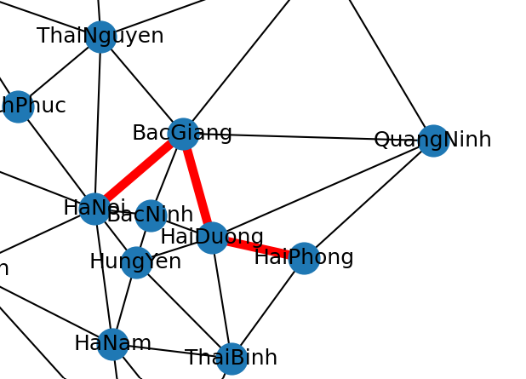
Optimality Comparison
The path produced by UCS and A* (which is optimal)
The path produced by GBFS (which in this case is not optimal)

Slide 23
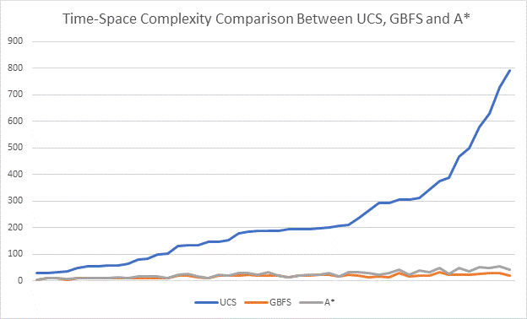
UCS vs GBFS, A*
Comment
Having no heuristic function: f(n) = g(n) (i.e cannot deal with heuristic function), UCS turns out to be much worse in computation time and memory required for storage compare to GBFS and A*
An admissible heuristic has great effect on the time and space complexity of a search algorithm.

Slide 24
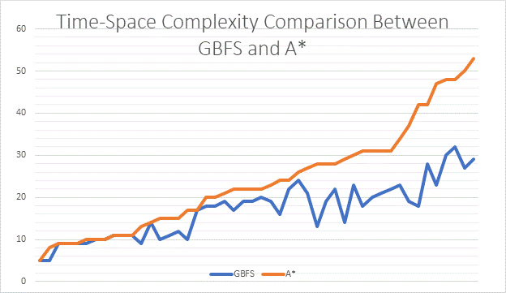
GBFS vs A*
Comment
In most test case, A* computation takes more time and uses more memory than GBFS
A* becomes impractical when the search space is huge.
However, A* also guarantees that the found path between the starting node and the goal node is the optimal one and that the algorithm eventually terminates.
GBFS, on the other hand, uses less memory, but does not provide the optimality and completeness guarantees of A*.

Slide 25

Problem
The space complexity of A* is roughly the same as that of all other graph search algorithms, as it keeps all generated nodes in memory. In practice, this turns out to be the biggest drawback of A* search

Slide 26

Memory-bounded Heuristic Searches
Iterative deepening A* (IDA*)
Memory bounded A*
Simplified Memory Bounded A* (SMA*)

Slide 27
Q&A
Question
Comment
Idea

Slide 28
Contact Us
Email
Phone
Trung.NK205133@sis.hust.edu.vn
0344130983

